Slide 1
Review of resilience of the health care system in Georgia – Assessment of the response of the Government of Georgia to COVID-19
July 2020

Slide 2
Outline
To be updated

Slide 3
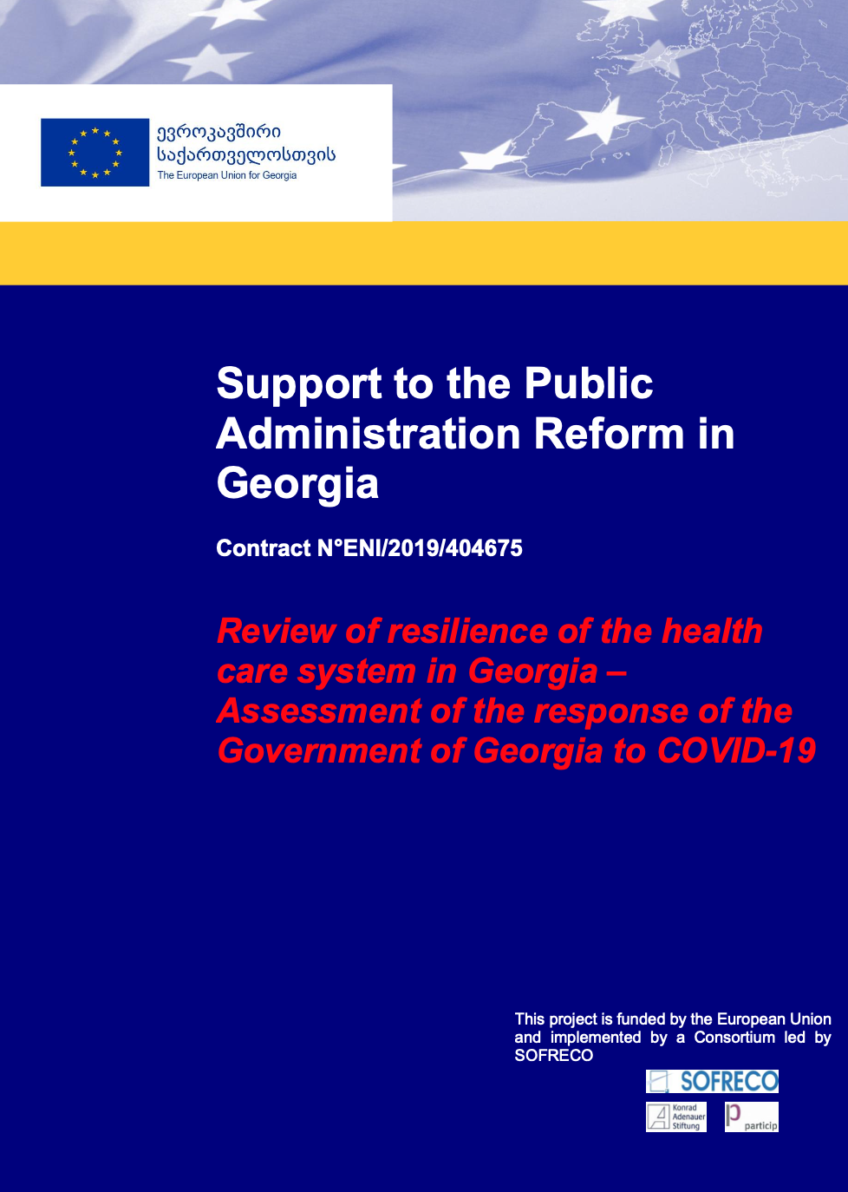
About the review
In the review the Government's measures against COVID-19 and their impact have been assessed in accordance with all building blocks of a health system.
The review assesses impact of the coronavirus outbreak on healthcare system and looks at needs for strengthening it.
It proposes required strategies and sets out list on recommendations – by using global experience, customized to Georgian context.
The review can serve as foundation for development of the National Post-COVID-19 Crisis Plan for the Health Sector.
It will also inform National Healthcare Strategy.

Slide 4
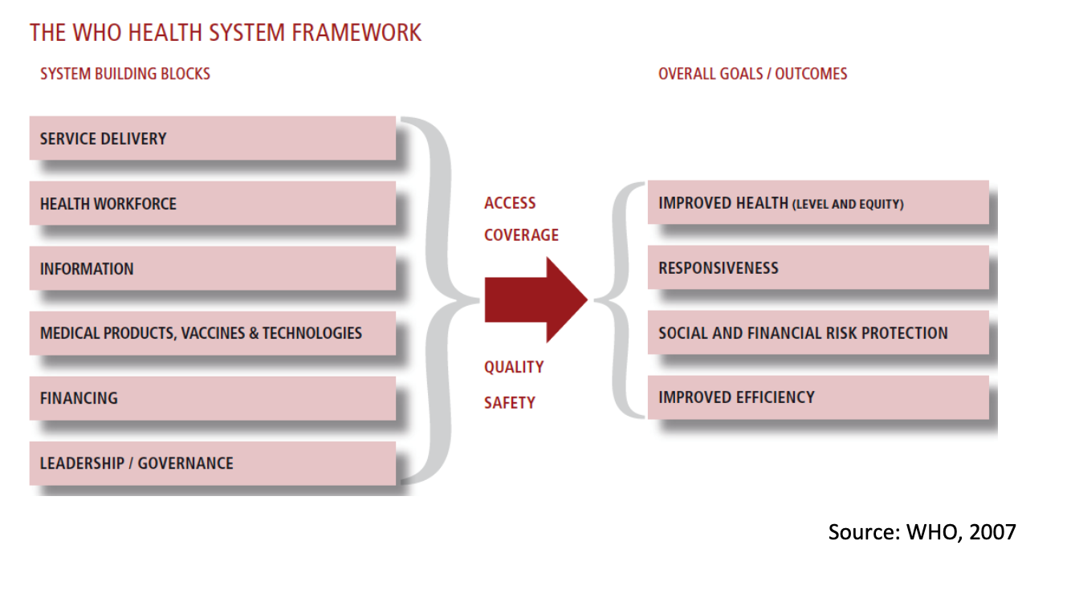
methodology

Slide 5
Summary Health System Resilience Strategy priority areas - Objectives
Main objectives:
  Protect people from serious cross-border health threats
  Improve crisis management capacity.
Specific objectives:
  Improve access to healthcare;
  Strengthen health system and develop the capacities of health care facilities and workforce;
  Make medicines, medical devices, and other crisis relevant commodities available and affordable;
  Invest in public health and develop capacities of public health institutions and professionals;
  Raise public awareness and support population-based health programmes through health promotion and disease prevention programmes.

Slide 6




Summary Health System Resilience Strategy priority areas - Planning
Create reserves of medical supplies in case of a crisis
Train healthcare professionals and create a pool of healthcare staff and experts that can be mobilised to prevent or respond to health crisis throughout the country or the region
Develop surveillance system
Improve the resilience of health systems to ensure better health outcomes for the population of Georgia
For future shocks, the government needs to consider following
$$1$$
$$2$$
3
$$4$$
Notes:
Saxelmwifoshi investicia -----
Developing surge capacity
Mandatory groups and testing practices

Slide 7
Summary Health System Resilience Strategy priority areas –Actions and resource allocation
Training and exchange programmes for medical and healthcare staff
New mechanisms for procurement of goods and services necessary for the prevention and management of health crises;
Audits of preparedness and response arrangements (such as reference laboratories, crisis management, antimicrobial resistance, vaccination) to ensure their effectiveness;
Clinical trials to speed up the development, authorisation and access to innovative, safe, and effective medicines and vaccines;
International (e.g. cross-border or regional) collaboration and partnerships (in particular, Eastern Partnership with the European Union);
Deployment, operation, and maintenance of digital service infrastructure;
Analytical and research activities such as studies, data collection and benchmarking
The following actions can be funded in future in areas related to potential health threats:
Notes:
The EU Health Programme has recently been published. The Programme will cover the period 2021-2027. It also takes into account the lessons learnt and gaps revealed by the novel coronavirus crisis to date, and will put in place structural changes to better prepare the EU for health challenges https://eur-lex.europa.eu/legal-content/EN/TXT/?uri=CELEX:52020PC0405

Slide 8
General Recommendations (i)
Effective coordination between the functions/building blocks of the health care system;
Strengthening preparedness at community level and involving civil sector organizations and patient groups into policy making;
Clear vision and feasible national health strategy providing a view for health system reform and strengthening beyond the scope of the health system resilience strategy itself;
Commitment of the Government to develop and implement heath system resilience strategy and national health strategy;
Communication with key stakeholders as well as the wider public, including policy dialogue as part of decision-making process;

Slide 9
General Recommendations (ii)
Setting goals and objectives;
Continuous monitoring and evaluation of the progress according to the goals and objectives to recognize impact on the situation and support authorities through policy making circle;
Considering experiences and lessons learnt during the current pandemic and beliefs and truths about shock, change and coping;
Regulating panic and emotions that might be based on lack of information or misinformation, as well as low or no trust in public authorities and medical/technical/scientific institutions;
Initiatives and being proactive to well prepare for similar or different shock in future that might challenge the health system and threaten the values and principles of provision of health care services.

Slide 10
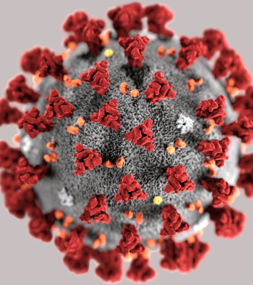
about CoVID-19 (SARS-CoV-2)
In December 2019, China reported the increasing occurrence of pneumonia in the city of Wuhan, Hubei province.
On 11 March 2020, WHO issued an announcement of the change in coronavirus disease 2019 status from epidemic to pandemic disease.
COVID-19 can make anyone sick regardless their age, gender, race or ethnicity.
Common sympthoms are
  Fever
  Cough
  Shortness of breath or difficulty breathing
  Fatigue
  Muscle or body aches
  Headache
  New loss of taste or smell
  Sore throat
  Congestion or runny nose
  Nausea or vomiting
  Diarrhea
This Photo by Unknown Author is licensed under CC BY-NC-ND

Slide 11

Georgia
Confirmed cases: 1155
Recovered: 929
Deaths: 17
COVID-19 was reported in 188 countries globally
Confirmed cases: 16.7 million
Recovered: 9.76 million
Deaths: 661 thousand
This Photo by Unknown Author is licensed under CC BY-SA

Slide 12
COVID-19 response Phases
Prevention
Preparedness
Response
Recovery

Slide 13

What was Georgia’s approach to COVID-19?
This Photo by Unknown Author is licensed under CC BY-SA

Slide 14
Covid-19 response in Georgia
Stage 1
Preventing the spread of the virus
Stage 2
Slowing the spread of the Virus
Stage 3
Managing the Spread of the Virus
Stage 4
The Gradual Lifting of Restrictions and Adaptation

Slide 15
Stage 1 - Preventing the spread of the virus (1)
Actions were undertaken before the first case of coronavirus infection was confirmed in the country;
The Interagency Coordination Council (ICC) was founded on 28 January 2020;
ICC’s primary directions
  Healthcare – Protect the health and lives of the population;
  Economy – Management and recovery of the economy in the face of the global economic crisis;
  Security – Protect the people in Georgia;
  Supplies and logistics – Ensure uninterrupted supply of food to the population

Slide 16

The Interagency Coordination Council (ICC)

Slide 17
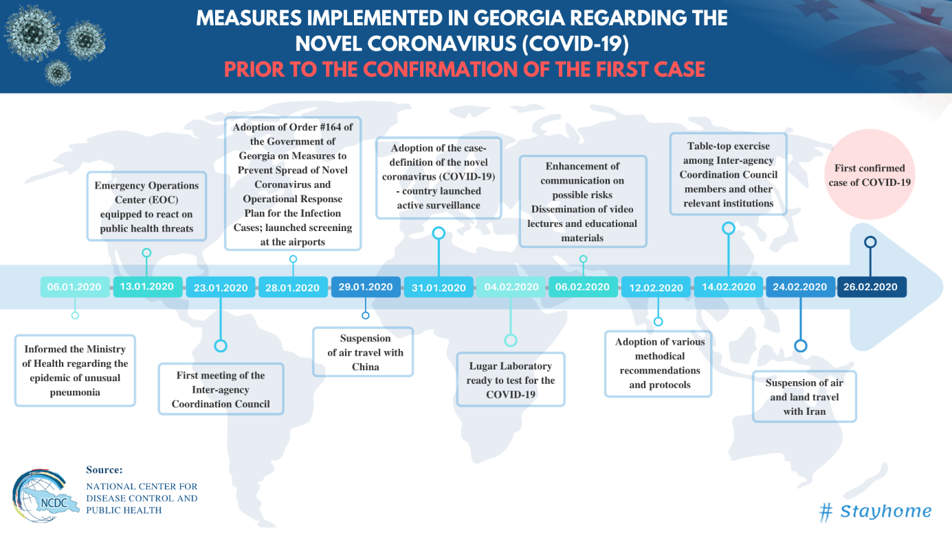
Stage 1 - Preventing the spread of the virus (1I)

Slide 18
Stage 2 - Management and recovery of the economy in the face of the global economic crisis
Several administrative measures in response to the spread of the novel coronavirus were implemented, such as:
  Closing schools and introducing home-school,
  Banning mass and public gatherings,
  Restricting economic activities and physical distancing,
  In addition to declaring a state of emergency throughout the country, including quarantine measures and curfew, as needed.

Slide 19
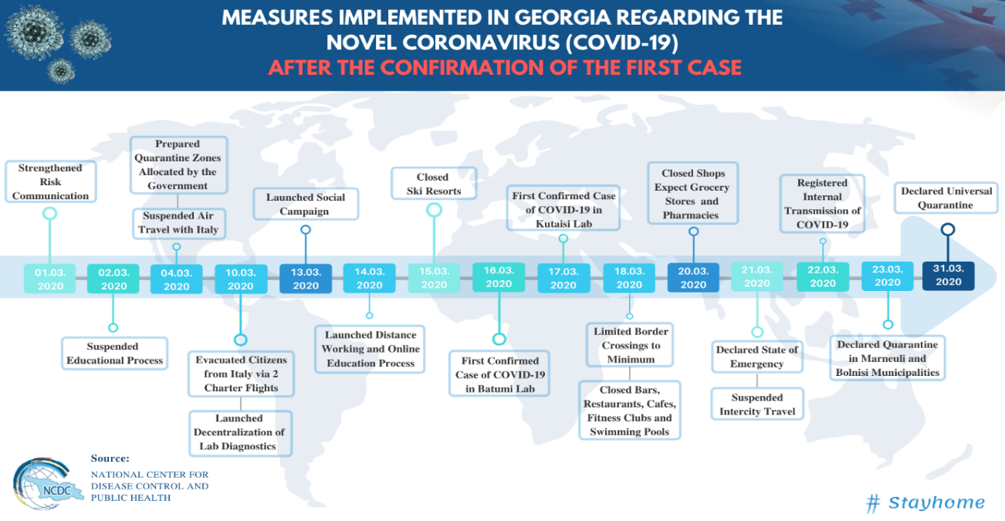
Stage 3: Protect the people in Georgia (i)

Slide 21
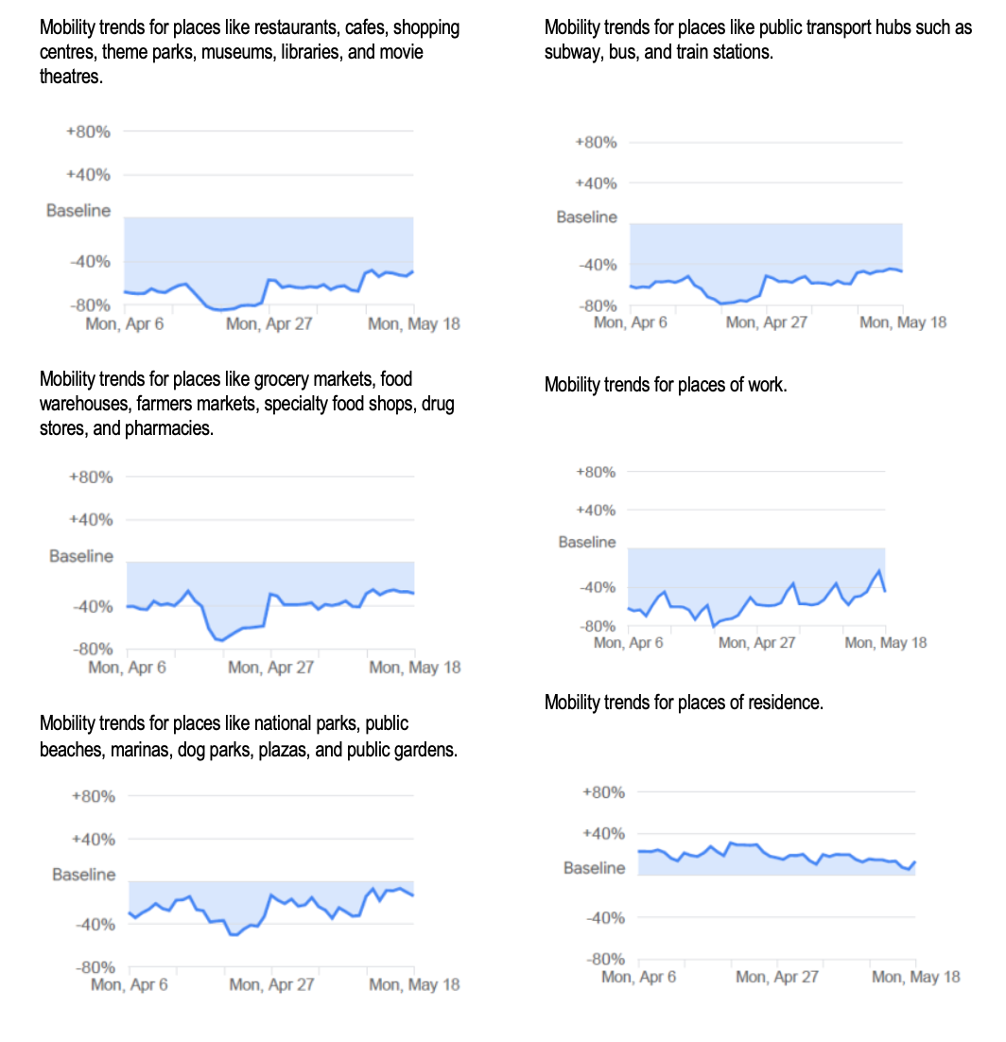
Stage 3: Protect the people in Georgia (iI)
Google’s Community Mobility Reports demonstrate that active communication campaigns resulted in limited mobility that was an effective measure against COVID-19

Slide 22
Stage 4 - Recovery
Stage 1
Started from 27 April 2020 and restrictions to support physical distancing were gradually lifted
Stage 2
Started from 5 May 2020 and includes restarting construction, production of construction materials, car wash services, technology repair businesses, and recreational zones (parks), public service halls and community centres.
Stage 3
Stage 4
Stage 5
Stage 6
Started from 11 May 2020 and shops (not shopping centres, shoe shops or clothes shops), open markets and publishing houses reopened, all kinds of production restarted, beauty parlours and aesthetic medical centres opened sooner than initially planned in Stage
Started from 1 June (instead of 8 June 2020 as planned before) and shopping centres and financial services reopened.
Starting from 22 June 2020 and closed markets and restaurants will reopen.
is expected to start from 6 July 2020 and all activities are expected to be back to normal, including opening hotels, schools, bars, casinos, and entertainment and sport facilities. Georgia intends to require valid COVID19 test results for all international travellers and visitors from 1 July 2020

Slide 23
How did Health system in Georgia responded to COVID-19?
This Photo by Unknown Author is licensed under CC BY-SA

Slide 24
Health care system’s response
Contain: detect early cases, follow up close contacts, and prevent the disease taking hold in this country for as long as is reasonably possible;
Delay: slow the spread in the country, if it does take hold, lowering the peak impact and pushing it away from the start of the outbreak;
Research: better understand the virus and the actions that will lessen its effect on the population; innovate responses including diagnostics, drugs, and vaccines; use the evidence to inform the development of the most effective models of care;
Mitigate: provide the best care possible for people who become ill, support hospitals to maintain essential services and ensure ongoing support for people ill in the community to minimise the overall impact of the disease on society, public services and on the economy

Slide 25
Health System’s response - Georgia
Together the MoIDPLHSA and the NCDC, took following actions:
    Identify and characterise the nature of the virus and the clinical severity of the disease (COVID-19)
    Minimise transmissibility, morbidity, and mortality
    Inform, engage, and empower stakeholders and the public
Notes:
Identify and characterise the nature of the virus and the clinical severity of the disease (COVID-19) – Much is still unknown about the novel coronavirus, however scientific information and knowledge are developing continuously.
Minimise transmissibility, morbidity, and mortality – The appropriate, proportional, and effective response of the health care system requires the government, health sector industry, other sectors of the national economy and the public/communities to work together.
Inform, engage, and empower stakeholders and the public – Communication is crucial and of priority to ensure stakeholders are able to cooperate and the public is provided with timely information and advice. Health specialists need to be provided with accurate and comprehensive medical information to manage patients; implement novel coronavirus control measures and minimise their own risk of exposure.

Slide 26
Proportionate public health and health care system response (i)
The Government took steps during the fight against coronavirus as follows:
  Ensured the resources and systems required for an effective national response;
  Introduced and maintained restrictions and limitations, among others in crossing international borders;
  Ensured that Georgia met its international obligations and took part in regional/international coordination;
  Worked with healthcare providers to set standards to promote the safety and security of people;
  Established and maintained infection control guidelines, healthcare safety and quality standards.

Slide 27
Proportionate public health and health care system response (ii)
The Government in close collaboration with health authorities
  Undertook contact tracing;
  Coordinated distribution of personal protection equipment and medicines according to antiviral treatment protocols;
  Implemented social distancing measures as per national recommendations and local risk assessment; and
  Implemented infection control guidelines and healthcare safety and quality standards;
  Developed and validated specific SARS-CoV-2 tests;
  Undertook SARS-CoV-2 laboratory testing as required to monitor the outbreak and for individual patient care;

Slide 28
Provision of quality care
The Government in close collaboration with health authorities/organizations:
  Developed new models of care to manage patients and agreed on novel coronavirus triage criteria;
  Tailored infection control guidelines to the risks relevant to the virus;
  Ensured provision of primary health care is adapted to the changes in the needs of vulnerable groups during the outbreak;
  Considered and responded to requests for health assistance;
  Assessed and reorganize capacities of service provision to fill in identified gaps and supported hospitals in coping with increased demand by considering opening more beds, changing staff to patient ratios;
  Cancelled elective procedures and worked in partnership with private hospitals to manage urgent cases where appropriate.

Slide 29
Communication and information to communities and stakeholders
A comprehensive communications strategy was developed and implemented across all stages of the COVID-19 response.
The communications were designed to reach the broad range of stakeholders involved in and affected by the novel coronavirus pandemic, from health authorities and the medical profession, to the public and the media.
The Government also ensured regular reporting to and liaison with the WHO and sharing information from the WHO, from surveillance and other sources with relevant stakeholders.
The Government disseminated relevant information to aged care and residential facilities, and liaised with education authorities concerning public health measures related to schools.

Slide 30
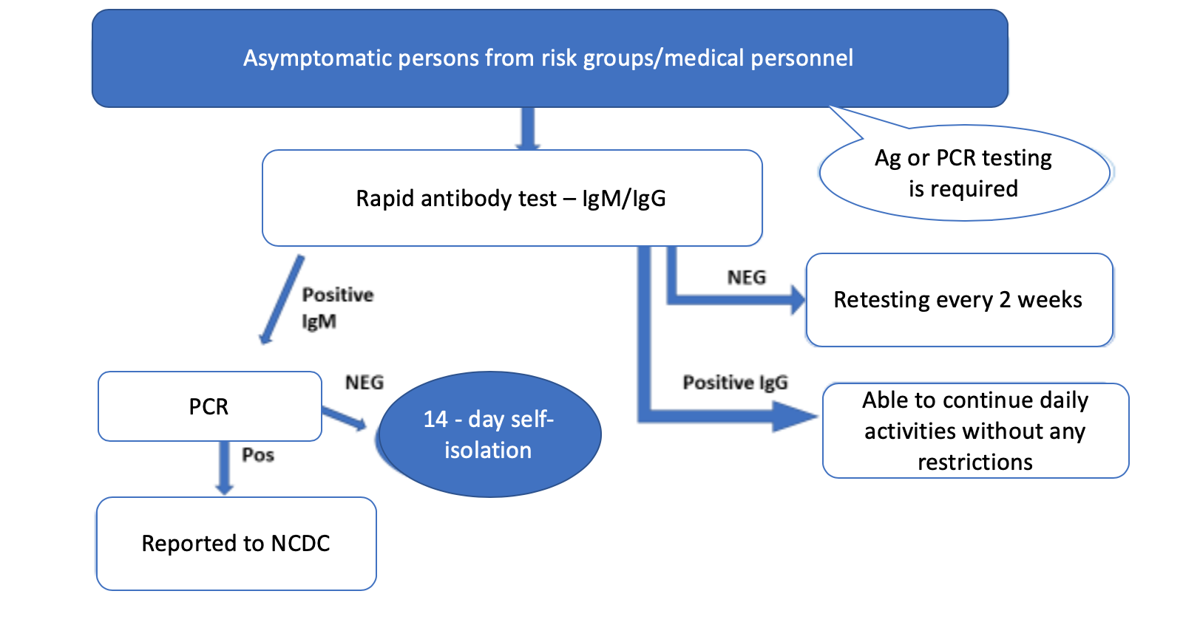
Testing Practices (1)
The Minister’s Decree #01-119/O approved on March 24, 2020 on “Clinical guidelines to diagnose, treat and manage COVID-19 cases”

Slide 31
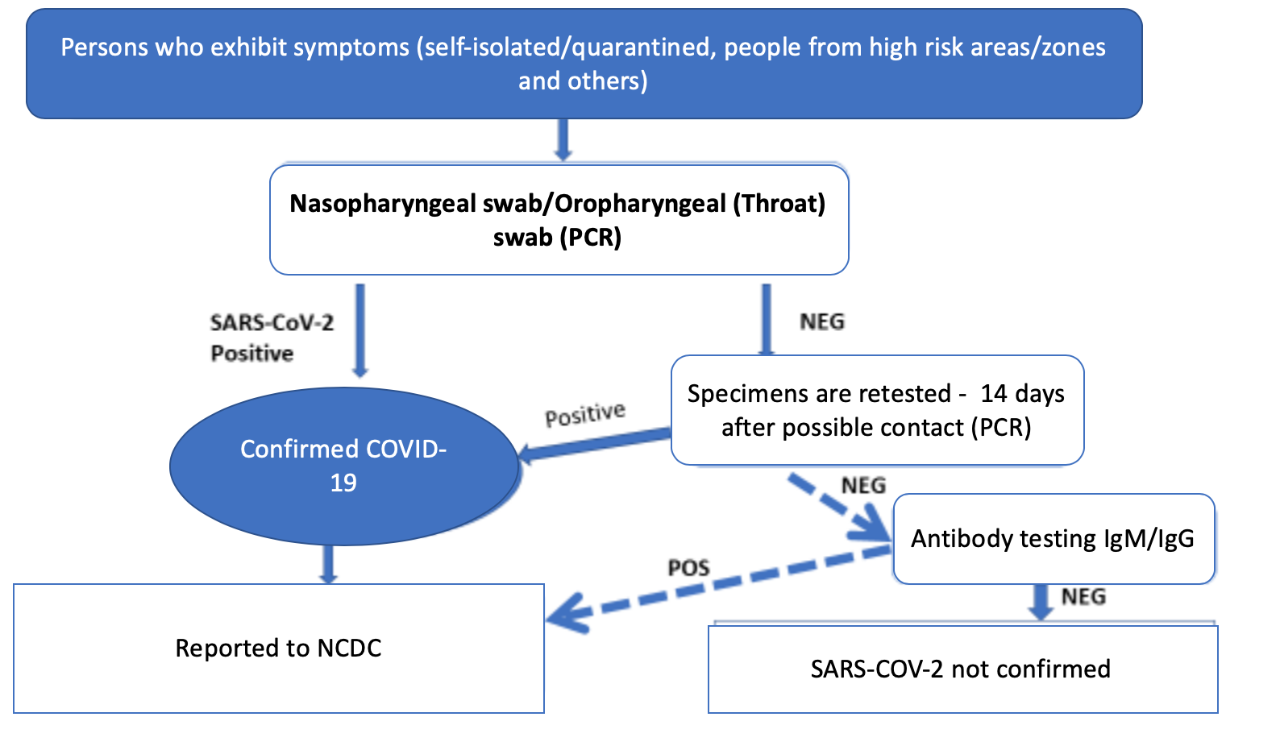
Testing Practices (11)
The Minister’s Decree #01-119/O approved on March 24, 2020 on “Clinical guidelines to diagnose, treat and manage COVID-19 cases”

Slide 32
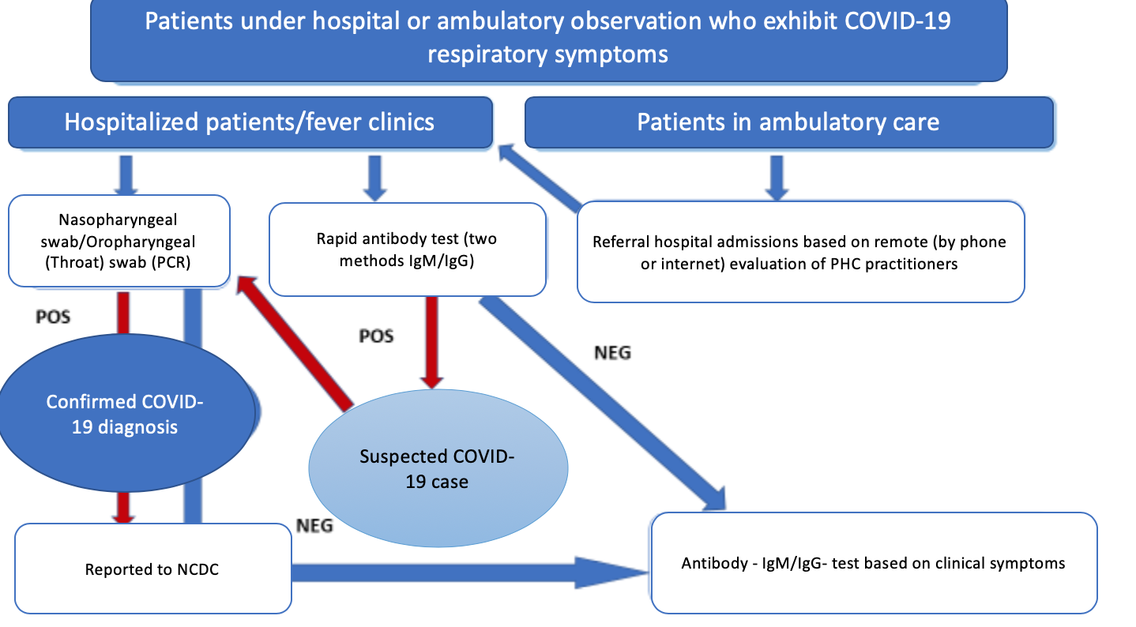
Testing Practices (11i)
The Minister’s Decree #01-119/O approved on March 24, 2020 on “Clinical guidelines to diagnose, treat and manage COVID-19 cases”

Slide 33
Joint Three ministers’ executive order (1)
On June 5 of 2020, the Ministry of Economy and Sustainable Development, the Ministry of Internally Displaced Persons, Labour, Health and Social Affairs, and the Ministry of Finance have adopted a joint executive order №1-1/208 – №01-55/N – №127;
The executive order on Epidemiological Control and Quarantine Rules for Drivers of International Export (exception only applies to transit drivers);

Slide 34
Joint Three ministers’ executive order (1I) – Trade Regulations at the customs (General)
Customs officer provides full information on regulations set out by the executive order
If fever is detected drivers with international passport are denied the entry to Georgia
If fever is detected drivers with Georgian citizenship are placed in quarantine, observed at the fever clinics and tested using PCR method.
If fever is NOT detected, drivers are subject to rapid anti-body test.
If test results are negative, those under the observation at fever clinics are escorted to their vehicles by LEPL Land Transport Agency.
All drivers are subject of thermal screening by the medical staff placed at the border agencies
If test results are positive, drivers with Georgian citizenship are treated at the designated COVID-19 hospitals.

Slide 35
Joint Three ministers’ executive order (I1I) - Citizens of Georgia
Rapid antibody test at the customs
If results are negative the driver must be retested every 72 hours for 14 days (unless they exit country within first 72 hours)
If rapid antibody test is positive PCR test is obligatory; the driver is temporarily placed at the fever center
The information is reported to NCDC
LELP Revenue Service Agency notifies the employer of the driver
The employer is obliged to cover all costs related to testing

Slide 36
Joint Three ministers’ executive order (IV) – international passport holders
Thermal screening
If results are negative the driver must be retested every 72 hours (unless they exit country within first 72 hours)
Transit drivers, who pass through Georgia and stay in country for 48 hours must provide test results
The employer or a driver is obliged to cover all costs related to testing

Slide 37
Post-COVID-19 period
Prepare and support the return from emergency response to normal business services and implement interim arrangements as needed
At all levels, plan what is needed to protect the people, particularly the most vulnerable people, and address the needs of special groups, while monitoring for a second wave of the novel coronavirus outbreak or the appearance of any new health threat
Evaluate health system functions, and revise plans and procedures as needed

Slide 38
Indicators applicable for monitoring the implementation of the Country Preparedness and Response Plan
Category | Indicator | Remark
Epidemiology and Health Situation | Number of confirmed cases
 | Percentage of confirmed cases who are healthcare workers | This indicator can be useful to strengthen IPC.
 | Number or percentage of suspects
 | Percentage of fatal cases (deaths) among confirmed cases
Budget and Programme Management | Percentage of Total Health Expenditure allocated to Pandemic Plan / Country Preparedness and Response Plan | This indicator assesses the financial support to response according to CPRP.
 | Percentage of funds received for CPRP implemented | This indicator assesses the level of implementation of the response according to CPRP.
Personal Protection Equipment Supply | Percentage of personal protective equipment available in stocks comparing with those required by CPRP | This indicator focuses on capacity to deploy supplies.
 | Implementation index for stakeholders actively participating in CPRP | Indicates coordination in CPRP and contribution of private sector and civil sector organizations to CPRP.
Research and Development | R&D index (based on clinical trials and studies enrolled / being implemented / completed) | This indicator focuses on collaboration between scientific, academic and research institutions and involvement of those in implementation of CPRP.
Country Readiness and Response | Preparedness index and Response index | These indicators demonstrate the level of preparedness and operational readiness (response) based on the capacities defined and allocated for crisis.

Slide 39
Findings of the review

Slide 40
economic recovery and post crisis actions
The negative effect of the pandemic on Georgia’s economy:
  Economic growth: -4%
  Budgetary revenues: -1.8 billion GEL
  Reduction of current expenses: 300 million GEL
  International partners have allocated 3 billion USD for the country’s economy
The budget for the fight against COVID-19 (3.5 billion GEL)
  Caring for citizens and providing them with social support: 1.035 billion GEL
  Caring for the economy and supporting entrepreneurs: 2.11 billion GEL
  Strengthening the health care system and fighting against the pandemic: 350 million GEL

Slide 41
GoG introduced containment measures and governance structures, took steps to support health-care delivery and financing
developed and implemented plans and management structure.
Risk communication
Daily updates prepared and streamed by all medial platforms.
Materials are available in six languages
Trust in Government
Legislation
Planning
Non-pharmaceutical response
Coordination
Health Management Information System
Communication
GOVERNANCE
The Ministry, NCDC, health services managers took place regularly
The Ministerial Order No. 01- 62/o in February 2020;
Regulations on contact tracing, usage of PPE, sample collection, infection prevention and control.
Multisectoral response led by the Prime Minister
Response to outbreak designed around WHO and ECDC recommendations
Incidence management team at NCDC established .
Approval of Measures to Prevent the Possible Spread of the New Coronavirus in Georgia and Approval of an Emergency Response Plan”
Physical distancing, lockdown and quarantine, and mask wearing were also among strategies that were introduced (and later lifted) gradually and differently across the country .

Slide 42
Financing
Economics of response
Financing measures
Domestic funding
Donor funding
European Union funding
Rationing and financial decisions on use of available technologies are made daily;
In times of crisis, makers are willing to devote any amount to rescue all COVID-19 patient.
The Government covers all costs associated with the management of COVID-19.;
SSA reimburse health care providers in accordance with the Decree No 36 (GoG)
Temporary transfer to public and private hospitals in the form of a global budget to ensure standby readiness.
Initial COVID-19-related budget was GEL 3.5 billion;
GEL 50 million will be allocated for strengthening the health care system and fighting against the pandemic.
The amount of funds is totaling USD 1.5 billion, of which
IMF – USD 200 million
ADB – USD 400 million
AFD – USD 200 million
WB – USD 250 million
KfW – USD 250 million
EU – USD 200 million
AIIB – USD 100 million
On 30 March 2020 the European Commission provided EUR 20 million new funds o mitigate the impact of the COVID-19
Around EUR 70 million redirected funds to alleviate socioeconomic consequences

Slide 43
Resources
Institutional capacity
The Ministry assessed the capacities available at the health facilities and identified strategic stocks
Peak capacities
A total of 3,279 beds were mobilized across the country for COVID-19 patients;
Mobilization of medical personnel
1,245 employees of all COVID- 19 and fever clinics completed infection control trainings from February to April 2020;
Fever and COVID-19 management clinics were appointed.
1,050 beds were allocated to 16 Fever Clinics for the management of fever patients;
29 hospitals around the country accept COVID-19 patients.
2,500 doctors, were trained in early COVID-19 diagnostics and infection control;
Infection among health care personnel
5th- and 6th-year students were mobilized for the administration of the online consultations model.
A 2-week rotation scheme for personnel, including sufficient resting period;
Personnel’s employment in medical facilities providing non-COVID-19 services was restricted;
Since May, medical personnel undergo regular RT-PCR testing.
Medical supervision
The Ministry of Health has mobilized 405 doctors and nurses who were monitoring suspected cases at the areas of quarantine (Hotels)

Slide 44
Testing is based on PCR method and is currently carried out by 11 laboratories across the country:
Daily capacity of existing designated laboratories is around 15000+ tests.
Primary care doctors received calls (via emergency services-112) from people experiencing symptoms or who have had contact with confirmed case;
Telemedicine was also considered.
COVID-19 Clinical Management Group was established, and the National COVID-19 Treatment Guidelines were developed
Testing
Contact tracing
Primary healthcare
Critical care
Quality health services
Management of non-COVID-19 cases
Contact-tracing group consists of NCDC and municipal public health centers staff, infectious diseases and epidemiology specialists.
There were 1,297 ICU beds in January 2020 in Georgia (3.5 per 10,000 population)
The Government developed plans to sustain routine health- care services. The ICU capacities seem to be sufficient though, those need to be shared between COVId-19 and non- COVID-19 care.
Service Delivery

Slide 45
Recommendations

Slide 46
Recommendations for Exit
The infection status
Capacity of public health services
Capacity of health system
Primary health care
Community acceptance
Notes:
Pages 84-86

Slide 47
Recommendations for post-COVID-19 period
Recommendations are built around six building blocks of health system and cover the period after the (first wave of) COVID-19 epidemic.
Recommended actions are scheduled in accordance with short term (1-3 months), medium term (4-6 months) and long term 7-24 months).

Slide 48




Governance
Financing
Resources
Service Delivery
Coordinate the stand down of enhanced measures; manage the transition of novel coronavirus outbreak specific processes into normal business arrangements; and undertake public communication regarding changing risk and the stand down of measures.
State and regional governments shall work together to determine when to cease/reduce or even reimpose measures and agree appropriate messaging for stakeholders and the public concerning scaling down of measures.
Revise national legislation for the organization and provision of health care services.
Revise national legislation on public health and emergency response to support outbreak response specific activities.
Regional governments need to update their own plans and protocols applicable for the recovery phase.
Develop and maintain systems to monitor communicable disease activity domestically and internationally and for communicating relevant information.
Collecting surveillance data to contribute to the national public health information system and to contribute to the necessary public health response.
Coordinate and carefully plan measures to control the spread of the disease, proportional public health response and provision of quality care, as well as rebuild/strengthen the health system, as necessary.
Assess the risk of a second wave of the outbreak to inform decision making about appropriate actions.
Develop communication strategy to raise awareness of at-risk groups to build resilience within the most vulnerable populations.
Assess the financial needs and estimate the additional financial burden in the health care system (e.g. those for medical/technical equipment, consumables, drugs as well as human resources, such as different specialists and nurses).
Decide on financial support and subsidizes to health care financing.
Coordinate the allocation of available national and international resources required for clinical care.
Assess the needs for hospital beds, medical/technical equipment, consumables, drugs as well as human resources, such as different specialists and nurses.
Coordinate the allocation of available national resources required for clinical care.
Ensure appropriate Personal Protective Equipment for frontline staff and other specialists
Further support health professionals by providing necessary logistical support (repurpose hotels close to hospitals, transport services, etc.) and/or psychological support
Public health institutions across the country need to have sufficient capacity in terms of workforce and laboratories equipped with testing equipment/kits, transportation, and other logistics.
To ensure effective surveillance capacities needed for data collection and analysis, modelling and projections should be made available.
Make hospital capacities available according to surge capacity plans, particularly intensive care beds, oxygen supply and ventilators according to actual need, and regularly adapt to the evolving situation.
Keep contingency plans updated to cover situations where there are shortages of critical capacities (e.g. free resources by cancelling elective diagnostic and operative procedures and re-assign human resources, review non-essential services regularly, etc.)
Enable rapid registering, provide appropriate training and reallocation/mobilization of medical professionals, qualified nurses, and medicine students, as needed.
Review the current practices and protocols, and develop new models of care to manage patients and agree on novel coronavirus triage criteria as required.
Identify, isolate, and test all suspect coronavirus positive cases.
Trace, quarantine and monitor the health of all contacts.
Ensure non-COVID-19 patients with immediate or postponed health needs to health care, while maintain extra or dedicated/separated capacities for current and new COVID-19 patients.
Develop therapeutic solutions considering the latest, most effective, and evidence-based technologies.
Designate treatment facilities for mild, sub-intensive and intensive care needs.
Symptomatic patients must avoid infecting others: develop alternatives to limit avoidable presence at healthcare facilities (e.g. telemedicine, e-health, m-health solutions).
Advise patients on self-isolation at home under medical supervision until symptoms improve or worsen (i.e. mild cases)
Limit the spread as necessary by denying access to hospitals for visitors of admitted patients.
Monitor the novel coronavirus outbreak continuously, and evaluate the health system functions continuously, and implement response activities whenever possible to promote robust recovery.
Short term (1-3 months)

Slide 49
Governance
Financing
Resources
Service Delivery
Develop health system resilience strategy to ensure preparedness in the health care system and sustainability of the system (specific objectives of the health system resilience strategy should be as follows: improve access to healthcare; strengthen health system and develop the capacities of health care facilities and workforce; make medicines, medical devices and other crisis relevant commodities available and affordable; invest in public health and develop capacities of public health institutions and professionals; raise public awareness and support population based health programmes through health promotion and disease prevention programmes).
Make plans according to the following: create reserves of medical supplies in case of a crisis; train healthcare professionals and create a pool of healthcare staff and experts that can be mobilised to prevent or respond to health crisis throughout the country or the region; develop surveillance system; improve the resilience of health systems to ensure better health outcomes for the population of Georgia.
Establish and strengthen international (e.g. cross- border or regional) collaboration and partnerships (in particular, Eastern Partnership with the European Union ).
Make financial resources available for actions designed and implemented according to the objectives of the health system resilience strategy. Both domestic/budgetary resources and external/donor funding could be allocated for the implementation of the strategy.
Develop new mechanisms for procurement of goods and services necessary for the prevention and management of health crises.
Maintain short term actions and provide capacities as required / in accordance with the health system resilience strategy.
In addition, the following actions can be implemented as part of the health system resilience strategy: Training and exchange programmes for medical and healthcare staff; Audits of preparedness and response arrangements (such as reference laboratories, crisis management, antimicrobial resistance, vaccination) to ensure their effectiveness; Clinical trials to speed up the development, authorisation and access to innovative, safe and effective medicines and vaccines; Deployment, operation and maintenance of digital service infrastructure; Analytical and research activities such as studies, data collection and benchmarking.
Ensure accessible, effective, efficient, equitable, quality health services the population need in accordance with the needs assessment for proportional COVID-19 response in addition to care to non-COVID-19 patients.
In case of second wave of the novel coronavirus epidemic/pandemic, provide the necessary health services (see above)
Medium term (4-6 months)

Slide 50
Governance
Financing
Resources
Service Delivery
Further to crisis preparedness and response, the health system resilience strategy needs to address other important long-term challenges for health system: inequalities in health status among population groups, regions, and access to affordable health care of good quality; burden from non-communicable diseases and health risks and determinants; uneven distribution of health care systems capacity; digitalization, e-health and telemedicine; environmental health and pollution, in particular air, water and soil quality, and climate change.
Make financial resources available for actions designed and implemented according to the long-term actions defined in the health system resilience strategy. Both domestic/budgetary resources and external/donor funding could be allocated for the actions.
Maintain short term and medium-term actions and provide capacities as required / in accordance with the health system resilience strategy.
Ensure accessible, effective, efficient, equitable, quality health services the population need in accordance with the needs assessment for proportional COVID-19 response in addition to care to non-COVID-19 patients.
In case of second wave of the novel coronavirus epidemic/pandemic, provide the necessary health services
Long term (7-24 months)

Slide 51
Thank you

